Slide 1

RevPasswordManager
A secure and intuitive solution for managing your digital credentials.
Developed By:
Cheruku Sidhu
Begari Rahul
Deety Venkatesh
Lingampally Ganesh
Gavinimekala Manikanta
Palagani Charitha Sri

Slide 2




Application Overview: Your Digital Vault
RevPasswordManager is a full-stack, monolithic web application designed to provide robust security for your online accounts. It allows users to securely store, generate, and manage their passwords with ease, prioritising encryption, master password protection, and two-factor authentication.
Secure Vault
Master Password
Encrypt and store all your account credentials in one place.
Your single key to unlock and protect all your stored information.
Two-Factor Authentication
Strong Password Generation
Add an extra layer of security to your account access.
Create robust, random passwords with customizable parameters.

Slide 3



Tech Stack
Built with modern and secure technologies to ensure reliability and performance.
Frontend: HTML (Thymeleaf), CSS, JavaScript
Backend: Java, Springboot, Log4j, Junit 5
Database: Oracle
Tools: Git

Slide 4
Core Functional Requirements: User Capabilities
Our password manager is built around a comprehensive set of features, ensuring a seamless and secure user experience for every aspect of password management.
1
Authentication & Account Management
Create, login, recover, and update your account settings securely, including 2FA setup.
2
Password Vault Management
Organise, view, search, filter, and manage all your stored password entries with ease.
3
Password Generator
Generate and save strong, customisable passwords directly into your vault.
4
Security Features
Benefit from master password re-entry, security alerts, and comprehensive audit reports.
5
Security Questions Management
Manage security questions for account recovery and enhanced security.

Slide 5
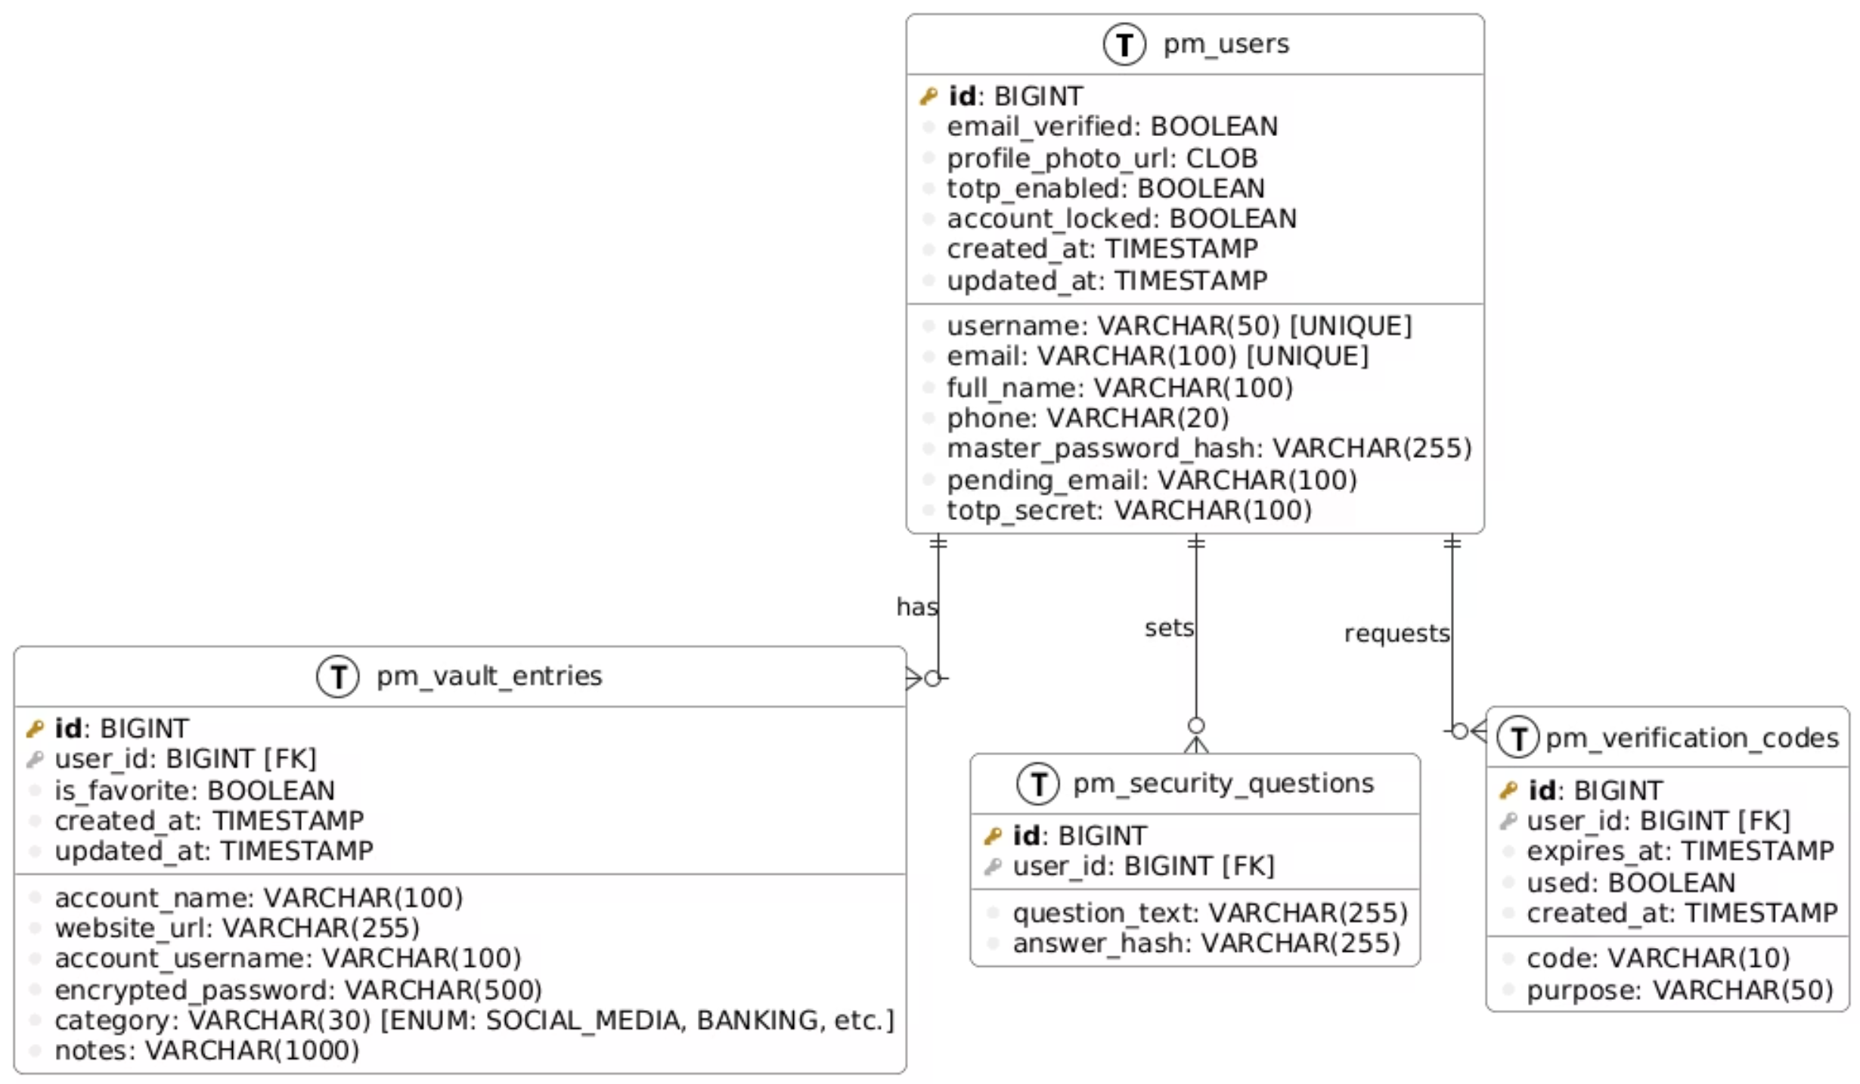
ER Diagram

Slide 6
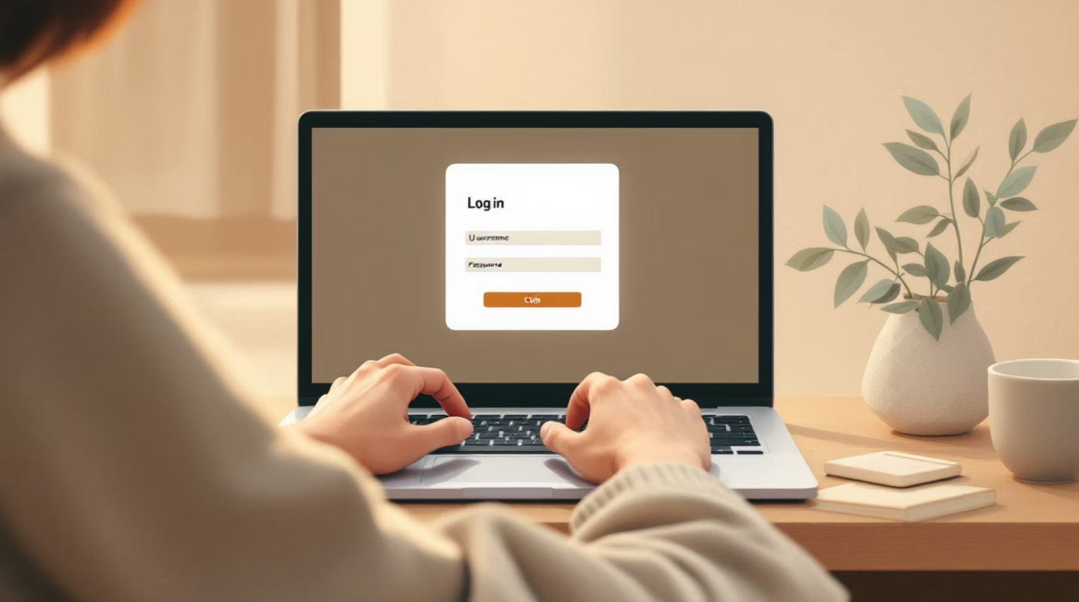
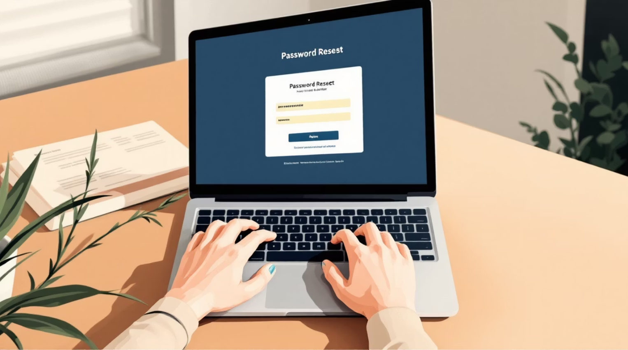
Authentication & Account Management
Create an account with email, username, and master password.
Set up a minimum of 3 security questions during registration.
Login using username/email and master password.
View dashboard with password vault summary.
Update profile information (name, email, phone number).
Change master password (requires current master password verification).
Recover forgotten master password through security questions.
Enable/disable two-factor authentication (2FA) via authenticator app simulation.
Logout securely from your account.

Slide 7
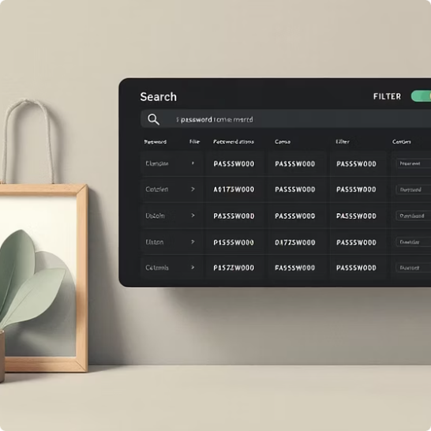


Password Vault Management
Your personal vault provides complete control over your credentials, from detailed views to efficient organisation.
Organise and Search
Detailed Entry Management
Favourite Passwords
View, search, filter by category, and sort password entries for quick access.
Mark passwords as favourites for instant retrieval and view your curated list.
Add, update, or delete entries with comprehensive details including notes and categories.

Slide 8
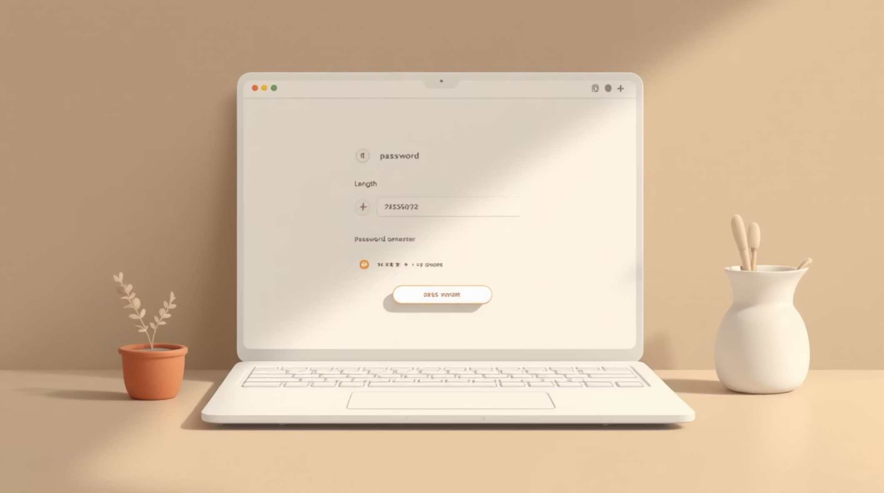
Powerful Password Generator
Generate strong, random passwords tailored to your needs. The generator offers full customisation to meet various security requirements.
Password length: 8-64 characters.
Include/exclude uppercase, lowercase, numbers, and special characters.
Exclude similar characters (0, O, l, 1, etc.) to avoid confusion.
Copy generated password to clipboard.
View password strength indicator (Weak, Medium, Strong, Very Strong).
Save generated password directly to vault.
Generate multiple passwords and choose the preferred one.

Slide 9



Security Features
We implement multiple layers of security to safeguard your sensitive information, ensuring peace of mind.
Master Password Re-entry
Verification Codes
Required for viewing sensitive information.
Email-based simulation for sensitive operations, expiring after single use or time limit.
Password Strength Analysis
Security Alerts
View strength analysis for all stored passwords.
Receive notifications for weak or reused passwords.
Security Audit Report
Two-Factor Authentication
Comprehensive reports on weak, reused, and old passwords.
Verifies with generated OTP’s via registered email.

Slide 10

Application Architecture
User Interface
Browser-facing client
Monolithic Web App
Database
Backend API
Persistent data store
Application logic and routing
The RevPasswordManager operates as a monolithic web application, integrating the User Interface, Backend API, and Database into a single, cohesive unit. This architecture simplifies development and deployment while maintaining strong performance and security for password management.

Slide 11
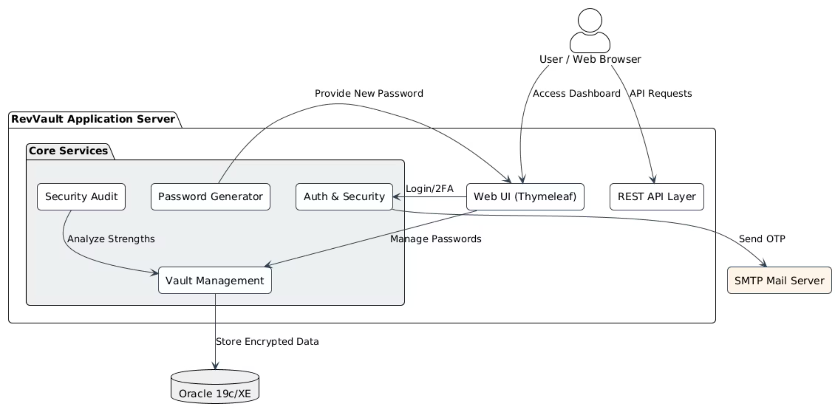
System Architecture
Our system architecture ensures a robust and secure environment. User requests are handled by the Web Server, routed to the Application Server for business logic, and data is stored in the Database Server. A dedicated Authentication Service manages user identity and access, reinforcing overall system security.

Slide 12
Future Enhancements
Cloud synchronization .
Develop a mobile application (Android and iOS) .
Browser extension Support .
Biometric authentication .
Dark Web Monitoring

Slide 13
Conclusion
The RevPassword Manager provides a secure and efficient way to manage digital credentials.
It allows users to store, generate, and manage passwords safely in an encrypted vault.
Security mechanisms such as BCrypt hashing, AES-256 encryption, and two-factor authentication ensure strong protection of sensitive data.
The system is built using Spring Boot, MVC architecture, and Oracle Database, making it scalable and maintainable.
Overall, the application improves password security, user convenience, and protection against cyber threats.

Slide 14
Thank You !!

